Slide 1

SERVERLESS
.NET Applications on AWS. Databases

Slide 2

AGENDA —
Serverless | . . . . . . . . . . . . . . . . . . . . . . . . . . . . . . . . . . . . . . | 02
Amazon Aurora Serverless | . . . . . . . . . . . . . . . . . . . . . . . . . . . . . . . . . . . . . . | 06
Amazon DynamoDB | . . . . . . . . . . . . . . . . . . . . . . . . . . . . . . . . . . . . . . | 16
AWS Lambda and other services | . . . . . . . . . . . . . . . . . . . . . . . . . . . . . . . . . . . . . . | 31
Application Overview | . . . . . . . . . . . . . . . . . . . . . . . . . . . . . . . . . . . . . . | 62
Practice | . . . . . . . . . . . . . . . . . . . . . . . . . . . . . . . . . . . . . . | 64

Slide 3
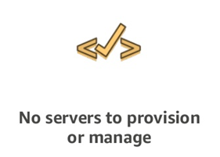
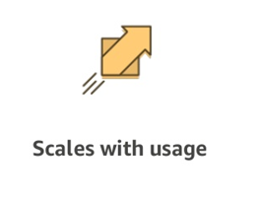
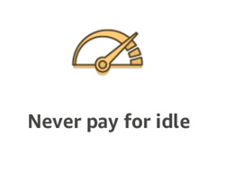
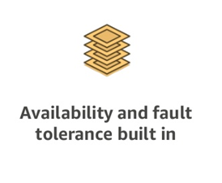
A SERVERLESS WORLD … —

Slide 4
SERVERLESS PROS
SERVERLESS CONS
No server management
Flexible Scaling
Pay for value
High availability
Time to market
“Greener” computing
Vendor control
Complexity
Configuration, deployment
Testing and Debugging

Slide 5
SERVERLESS. AWS Services —
COMPUTE AWS Lambda Lambda@Edge AWS Fargate | STORAGE S3 EFS | DATA STORES DynamoDB Aurora Serverless | ORCHESTRATION Step Functions
MESSAGING SNS SQS | API PROXY API Gateway | ANALYTICS Kinesis Athena | DEVELOPER TOOLING SAM X-Ray, Cloudwatch Codestar Codepipeline Codebuild Codedeploy Cloud9

Slide 6

Amazon Aurora Serverless —

Slide 7
Amazon Aurora Serverless —
Speed and availability of high-end commercial databases
Simplicity and cost-effectiveness of open-source databases
Drop-in compatibility with MySQL and PostgreSQL
Simple pay as you go pricing
Delivered as a fully managed service

Slide 8
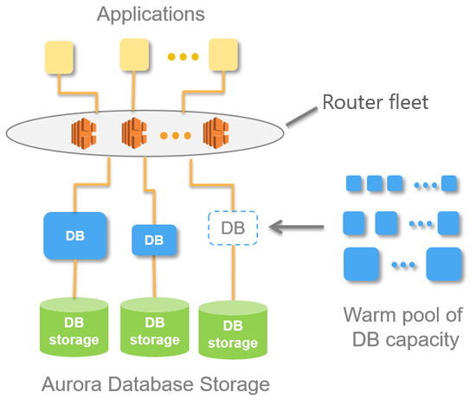
Amazon Aurora Serverless. Architecture —

Slide 9
Amazon Aurora Serverless. Scalability —
Scale capacity with no downtime
No application impact when scaling
Multi-tenant proxy is highly available
Scale target has warm buffer pool
Shuts down when not in use
Pay per second, 5 minute minimum

Slide 10
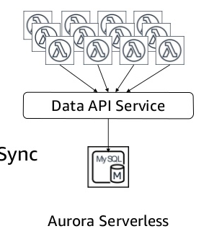
Amazon Aurora Serverless. Data API —
Simple web service protocol for database access
SQL statements packaged as HTTP requests
Access your database from AWS Lambda and AWS AppSync
Access your database from the AWS SDK & CLI

Slide 11
Amazon Aurora Serverless. Benefits —
HIGHLY SCALABLE
HIGHLY AVAILABLE
COST-EFFECTIVE
SIMPLE
TRANSPARENT
DURABLE

Slide 12
Amazon Aurora Serverless. Use Cases —
Infrequently used applications (non-prod environment)
New applications (startups)
Variable workloads
Unpredictable workloads (Black Friday)
Enterprise database fleet management v2
Software-as-a-Service applications v2
Scaled-out databases split across multiple servers v2

Slide 13
Amazon Aurora Serverless. Pricing —
Pay for the database capacity, storage, and I/O your database consumes when it is active.
Aurora Capacity Unit | $0.06 per ACU Hour
1 ACU has 2 GiB of memory with corresponding CPU and networking
Scale up latency | 5 to 50 seconds
Scale down latency | Up to 15 minutes
Starting capacity | 1 ACU
Capacity granularity | Doubles capacity with each increment

Slide 14
Amazon Aurora Serverless. Pricing —
Backup Storage | $0.021 per GB-month
Charge per GB of snapshot size: | $0.010
Storage Rate | $0.10 per GB-month
I/O Rate | $0.20 per 1 million requests
Data Transfer OUT From Amazon RDS To Internet
Up to 1 GB / Month | $0.00 per GB
Next 9.999 TB / Month | $0.09 per GB
Next 40 TB / Month | $0.085 per GB
Next 100 TB / Month | $0.07 per GB

Slide 15
Amazon Aurora Serverless. Limits —
Limited set of features (IAM authentication, Backtracking, Performance Insights, etc.)
Can't export snapshots to Amazon S3 buckets
Loading data from an Amazon S3 bucket
You can't use AWS DMS and CDC
Can't give a DB cluster a public IP address, only VPC
Limited set of cluster-level parameters
128TB of storage

Slide 16

Amazon DynamoDB —

Slide 17
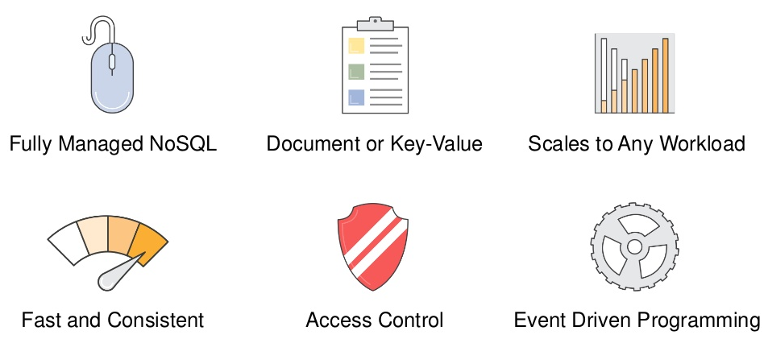
Amazon DynamoDB —

Slide 18
Amazon DynamoDB. Features —
Key-value and document data models
Global tables
Data Streams for DynamoDB
Read/write capacity modes
On-demand mode
DynamoDB Accelerator (DAX)
Auto scaling
Change tracking with triggers
ACID transactions
Encryption at rest
Point-in-time recovery
On-demand backup and restore

Slide 19
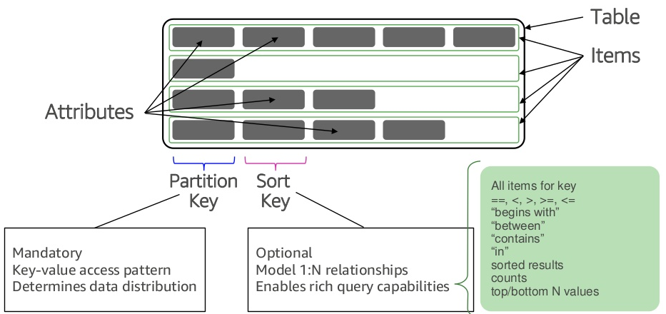
Amazon DynamoDB. Tables —

Slide 20
Amazon DynamoDB. Data Types —
Scalar Types
Number, String, Binary, Boolean, Null
Document Types
List (FavoriteThings: ["Cookies", "Coffee", 3.14159])
Map ({ ... })
Set (["Black", "Green", "Red"])

Slide 21
Amazon DynamoDB. Key Concepts —
Selecting a Partition Key
Large number of distinct values
Items are uniformly requested and randomly distributed
Selecting a Sort Key
Model 1:N and N:N relationships
Effective/selective patterns
Query multiple entities
Leverage range queries

Slide 22
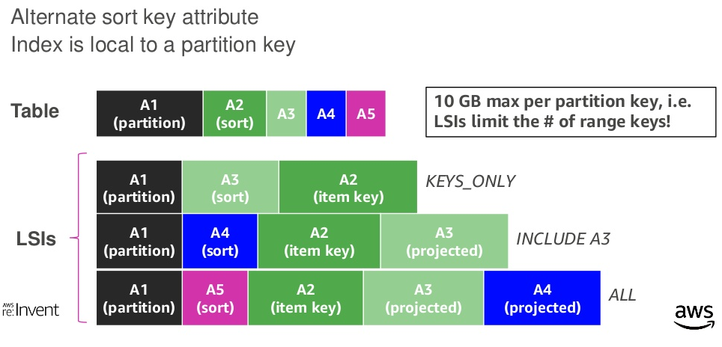
Amazon DynamoDB. Local Secondary Index (LSI) —

Slide 23
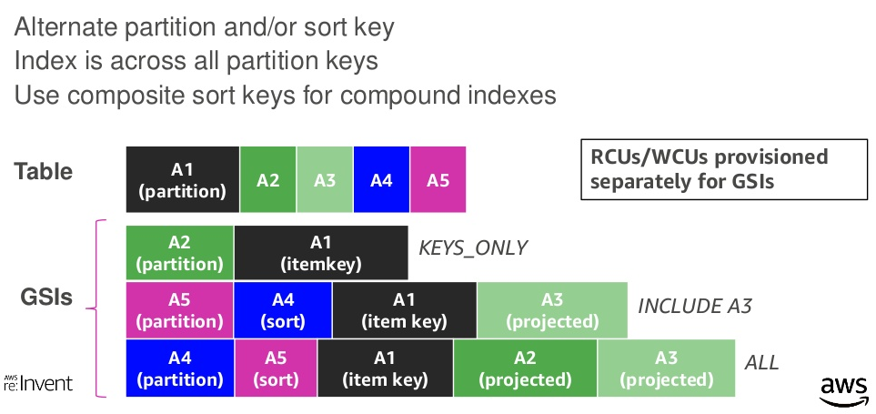
Amazon DynamoDB. Global Secondary Index (GSI) —

Slide 24
Amazon DynamoDB. API —
Control Plane (Create, Update, Delete table, List Tables)
Data Plane (CRUD on data, PartiQL)
DynamoDB Streams (ListStreams, GetRecords, GetShardIterator)
Transactions (ExecuteTransaction, TransactWriteItems, TransactGetItems)

Slide 25
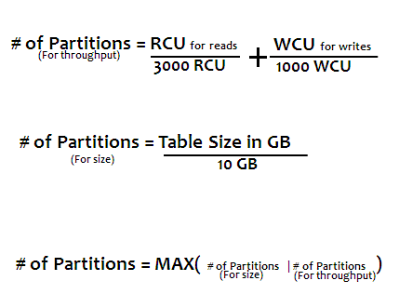
Amazon DynamoDB. Capacity —
Provisioned at the table level
WCUs are measured in 1 KB per second
RCUs are measured in 4 KB per second
Strongly consistent reads
Eventually consistent reads ½ cost
On-demand
Read and write throughput limits are independent

Slide 26
Amazon DynamoDB. Data Modeling —
Understand the use case
Identify the access patterns
Read/Write workloads
Query dimensions and aggregations
Data-modeling
Avoid relational design patterns, use one table
Review -> Repeat ->Review

Slide 27
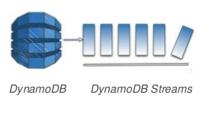
Amazon DynamoDB. Streams —
Streams of updates to a table
Asynchronous
Exactly once
Strictly ordered
Highly durable
Scale with table
24-hour lifetime
Sub-second latency

Slide 28
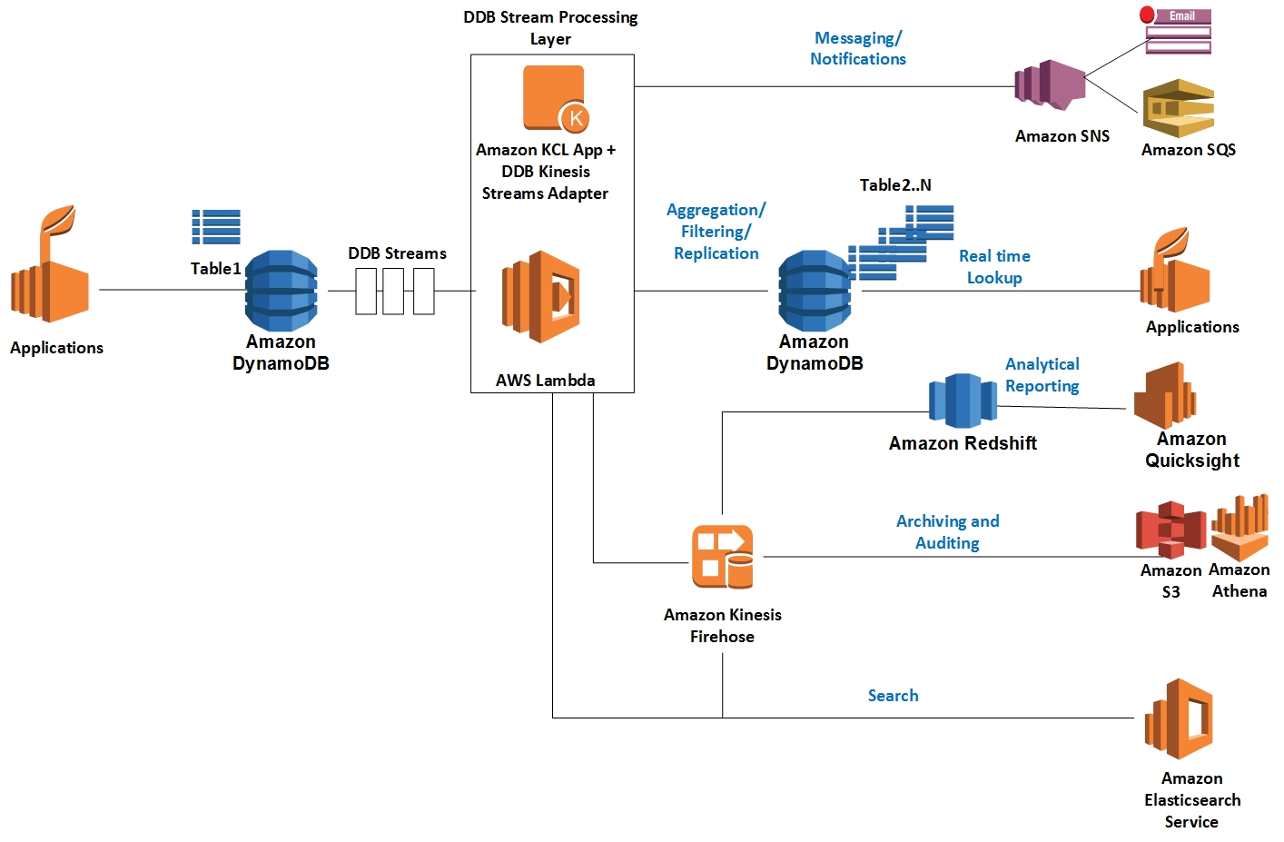
Amazon DynamoDB. Streams —

Slide 29
Amazon DynamoDB. Pricing —
Provisioned | Per Hour | On-demand | Per million
Write capacity unit (WCU) | $0.00065 per WCU | Write request units | $1.25
Read capacity unit (RCU) | $0.00013 per RCU | Read request units | $0.25
Data storage
$0.25 per GB-month
Backup
$0.20 per GB month
Streams
$0.02 per 100,000 read request units
Free Tier
25 GB per month
2.5 million stream read requests per month
1 GB data transfer out

Slide 30
Amazon DynamoDB. Limits —
There is no limit on a table's size
256 tables per AWS Region
5 local and 20 global secondary indexes
Partition Key maximum length is 2048 bytes.
Sort Key maximum length is 1024 bytes
The maximum item size in DynamoDB is 400 KB
Nested attributes up to 32 levels deep
Transaction cannot contain more than 4 MB and 25 unique items

Slide 31

AWS Lambda —

Slide 32
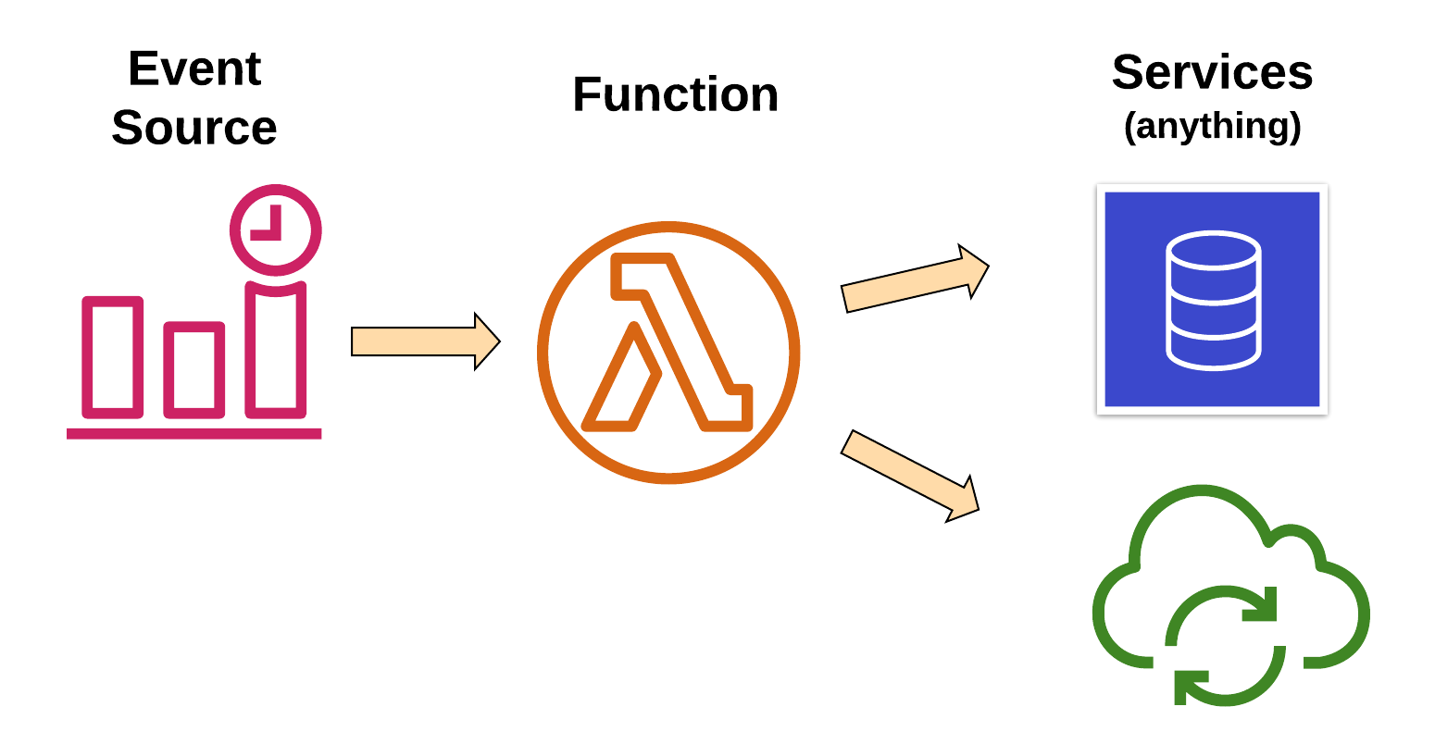
AWS Lambda. Overview —
Changes in data state
Requests to endpoints
Changes in resource state
Node.js, Python
Java, C#, Go, Ruby
Custom Runtime

Slide 33
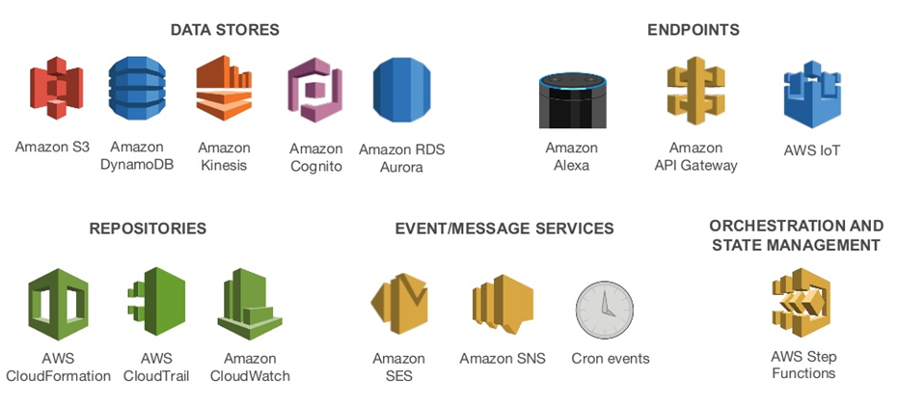
AWS Lambda. Event Sources —

Slide 34
AWS Lambda. Anatomy —
Handler() function
Function to be executed upon invocation
Event object
Data sent during Lambda function invocation
Context object
Methods available to interact with runtime information (request ID, log group, more)
public async Task FunctionHandler(S3Event input, ILambdaContext context)
{
foreach(var record in input.Records)
{
….
}
}

Slide 35
AWS Lambda. Handle —
Load Balancing
Auto Scaling
Handling Failures
Security Isolation
OS Management
Managing Utilization

Slide 36
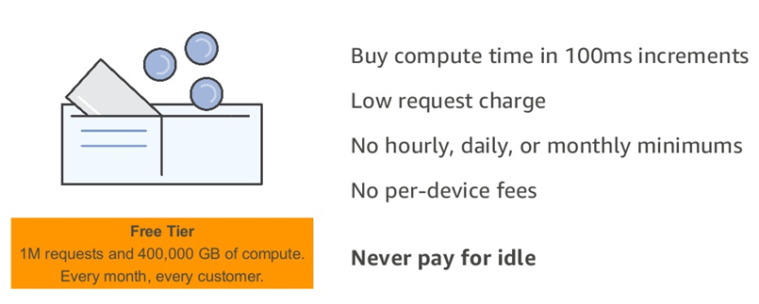
AWS Lambda. Fine-grained Pricing —
Requests | $0.20 per 1M requests
Duration | $0.0000166667 for every GB-second

Slide 37
AWS Lambda. Limits —
Concurrent executions | 1,000
Function and layer storage | 75 GB
Elastic network interfaces per VPC | 250
Function memory allocation | 128 MB to 3,008 MB, in 64 MB increments.
Function timeout | 900 seconds (15 minutes)
Function environment variables | 4 KB
Function resource-based policy | 20 KB
Function layers | 5 layers
Function burst concurrency | 500 - 3000 (varies per region)
Invocation frequency (requests per second) | 10 x concurrent executions limit (synchronous) 10 x concurrent executions limit (asynchronous – non-AWS sources) Unlimited (asynchronous – AWS service sources)
Invocation payload (request and response) | 6 MB (synchronous) 256 KB (asynchronous)
Deployment package size | 50 MB (zipped, for direct upload) 250 MB (unzipped, including layers) 3 MB (console editor)
Test events (console editor) | 10
/tmp directory storage | 512 MB
File descriptors | 1,024
Execution processes/threads | 1,024

Slide 38

AWS API Gateway —

Slide 39
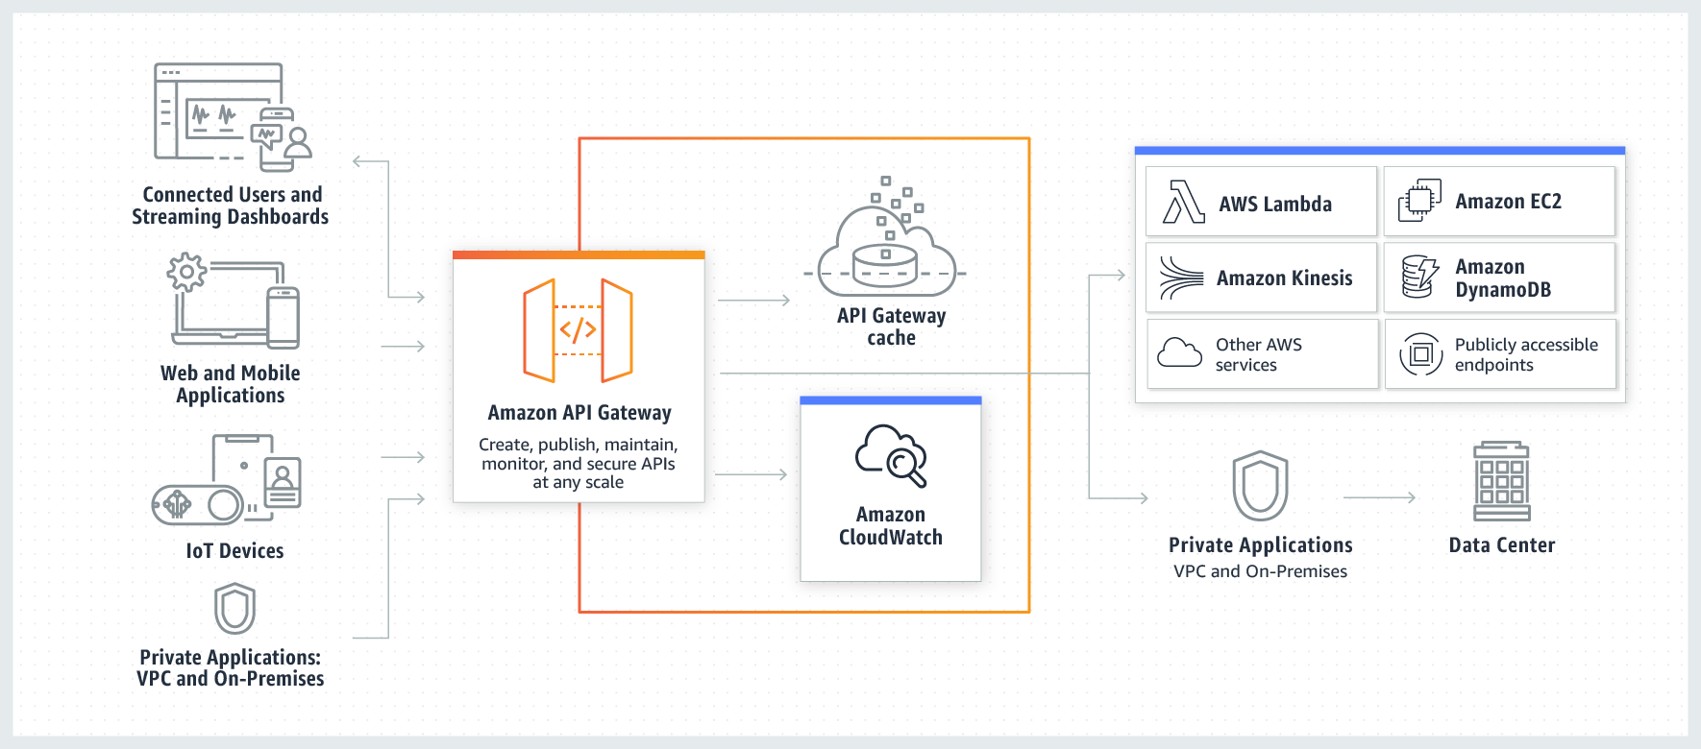
AWS API Gateway. Overview —

Slide 40
AWS API Gateway. Types —
API RESTful
API WEBSOCKET

Slide 41
AWS API Gateway. Features —
Host multiple versions and stages of your APIs
Create and distribute API Keys
Secure API
Throttle and monitor requests to protect your backend
Managed cache to store API responses
Reduced latency and DDoS protection through CloudFront
SDK Generation for iOS, Android and JS
Swagger and Open API support
Request/Response data transformation and API mocking

Slide 42
AWS API Gateway. Pricing —
FREE TIER
1M REST API CALLS RECEIVED | 1M HTTP API CALLS RECEIVED | 1M MESSAGES | 750,000 CONNECTION MINUTES
HTTP API Calls
First 300 million - $1
300+ - $0.9
REST API
First 333 million - $3.5
Over 20 billion - $1.51
Caching
58.2 GB - $1 per hour
WEBSOCKET API
First 1 billion - $1 per million
$0.25 per million connection minutes

Slide 43
AWS API Gateway. Limits —
Resource or Operation | Default Quota | Can Be Increased
Routes per API | 300 | Yes
Integrations per API | 300 | No
Maximum integration timeout | 30 seconds | No
Stages per API | 10 | Yes
Tags per stage | 50 | No
Total combined size of request line and header values | 10240 bytes | No
Payload size | 10 MB | No
Custom domains per account per Region | 120 | Yes
Access log template size | 3 KB | No
Amazon CloudWatch Logs log entry | 1 MB | No
Authorizers per API | 10 | Yes
Audiences per authorizer | 50 | No
Scopes per route | 10 | No
Timeout for JSON Web Key Set endpoint | 1500 ms | No
Timeout for OpenID Connect discovery endpoint | 1500 ms | No
VPC links per account per Region | 10 | Yes
Subnets per VPC link | 10 | Yes
Stage variables per stage | 100 | No

Slide 44

AWS Cognito —

Slide 45

AWS Cognito. Overview —
User Identity
Authentication
Authorization
User Management
Sign in users
Federation with enterprise identities
Federation with social identities
Standards-based (Oauth, SAML, OpentID)
Protect data and operations
Provide fine-grained access control
Manage user lifecycles
Store and manage user profile data
Monitor engagement

Slide 46
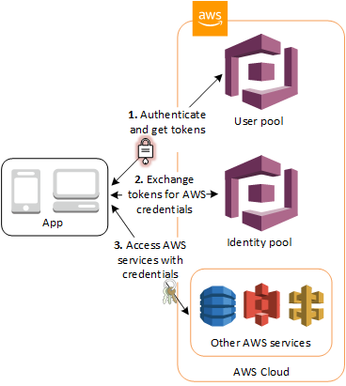
AWS Cognito. Overview —
User Pools
Domain
App Client
Resource Server
Identity Pools
Cognito Sync

Slide 47
AWS Cognito. User Pools —
Sign-up and sign-in services
A built-in, customizable web UI
Social sign-in - Facebook, Google, Amazon, SAML and OIDC.
User directory management and user profiles
Security features - MFA, checks for compromised credentials, account takeover protection, and phone and email verification
Customized workflows and user migration through AWS Lambda triggers

Slide 48
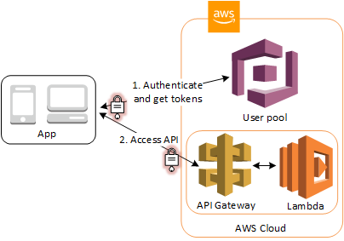
AWS Cognito. Native Support —
API Gateway Authorizers
ALB Authorizers

Slide 49

AWS CloudFormation —

Slide 50
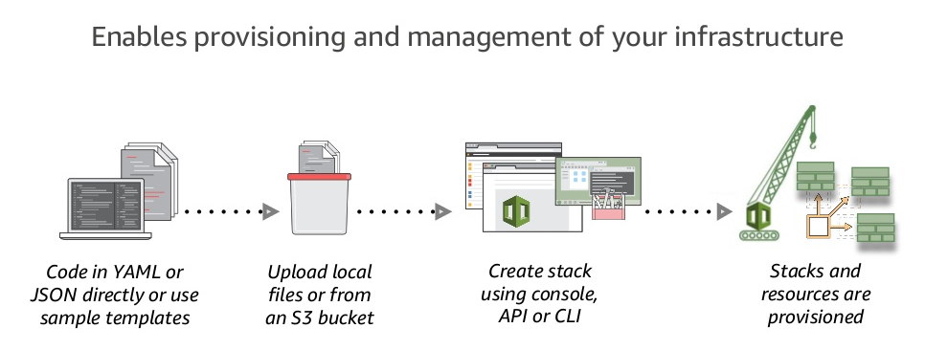
AWS CloudFormation at a Glance —

Slide 51
AWS CloudFormation. Features —
Native AWS Technology
Logical Components Relationship
Visualization
Rollbacks Support
Resources Cleanup
Preview Changes
Costs Trekking
Integration with other AWS Services
Safety Controls
Extensibility

Slide 52
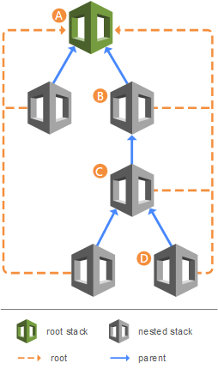
AWS CloudFormation. Stacks —
Create Deployment Stacks
Create Change Sets
Detect Changes
Nested Stacks
Stack Sets
CF CLI

Slide 53
AWS CloudFormation. Benefits and Tools —
Unify Deployment
Detect Changes
CDK
ClaudFormation Macroses
Infrastructure Tests/Validation Pipeline
AWS Serverless Application Repository
Different Deployment Types - Green/Blue, Canary, A/B Testing
AWS Service Catalog

Slide 54

AWS CloudFormation. SAM —
AWS CloudFormation extension or “transform”
Optimized for serverless apps
Serverless resource types: functions, APIs, tables
Support anything AWS CloudFormation support
SAM CLI

Slide 55

AWS CloudFront —

Slide 56
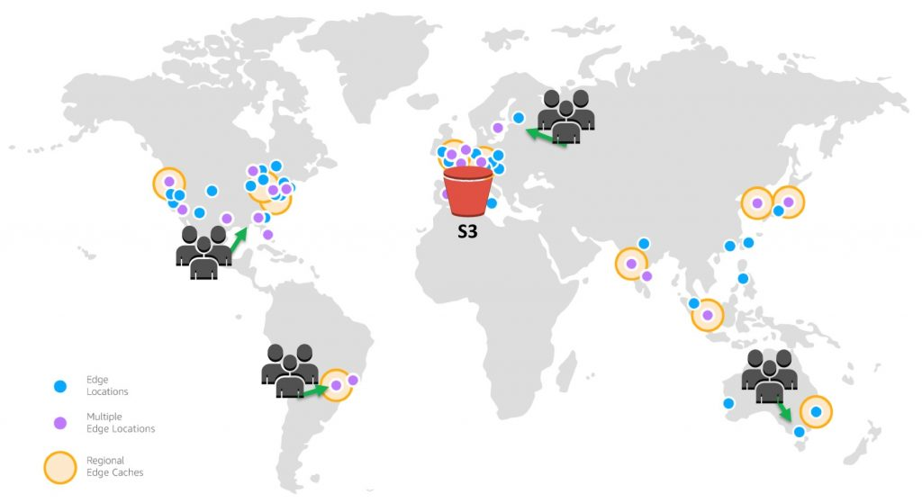
AWS CloudFront —

Slide 57
AWS CloudFront. Features —
Global Amazon Infrastructure
Security
Availability
Performance
Programmable and DevOps Friendly
Lambda@Edge
Cost Effective

Slide 58

AWS CloudWatch —

Slide 59
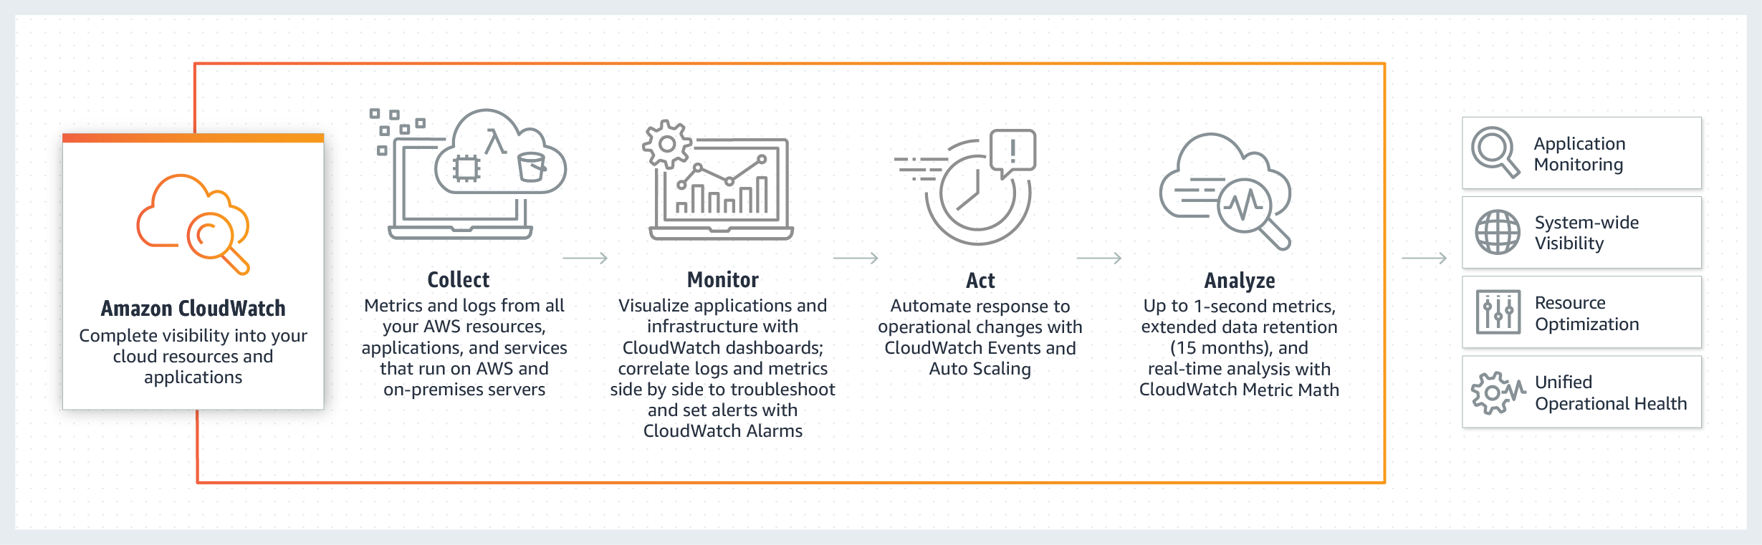
AWS CloudWatch. Overview —

Slide 60
AWS CloudWatch. Features —
Collect
Store logs and Build-in or custom metrics
Monitor
Operational dashboards
High resolution alarms, anomaly detection
Application Insights for .NET and SQL Servers apps
Act
Auto Scaling and CloudWatch Events
Analyze
Compliance and Security

Slide 61
APPLICATION OVERVIEW —
DEMO

Slide 62
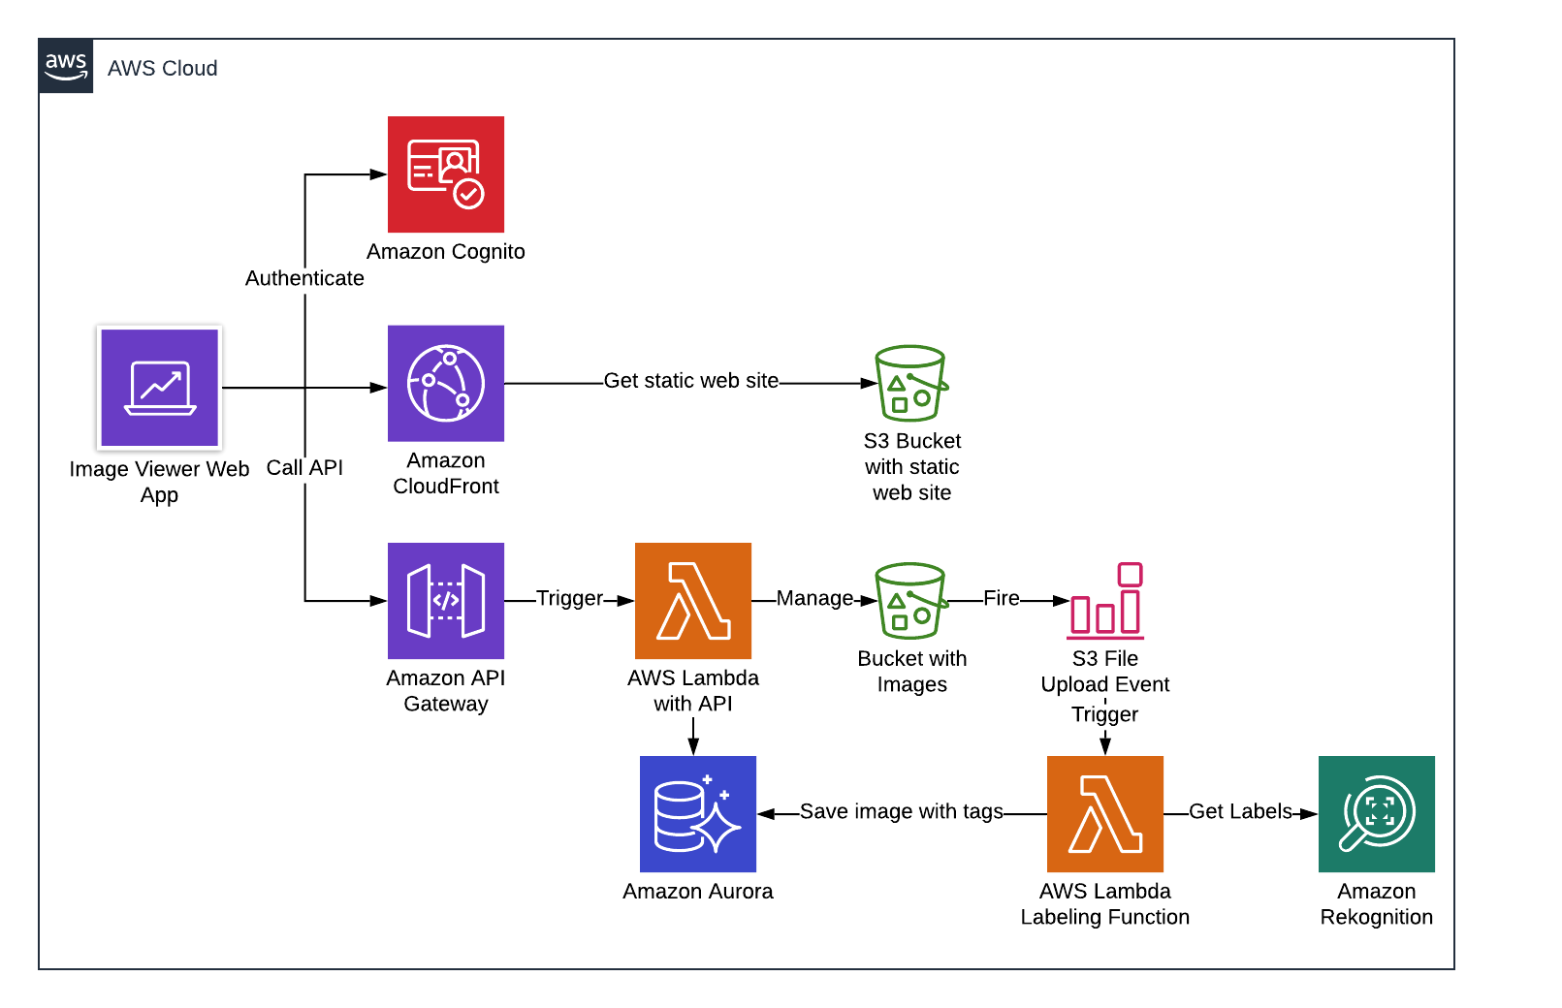
APPLICATION OVERVIEW. AMAZON AURORA SERVERLESS —

Slide 63
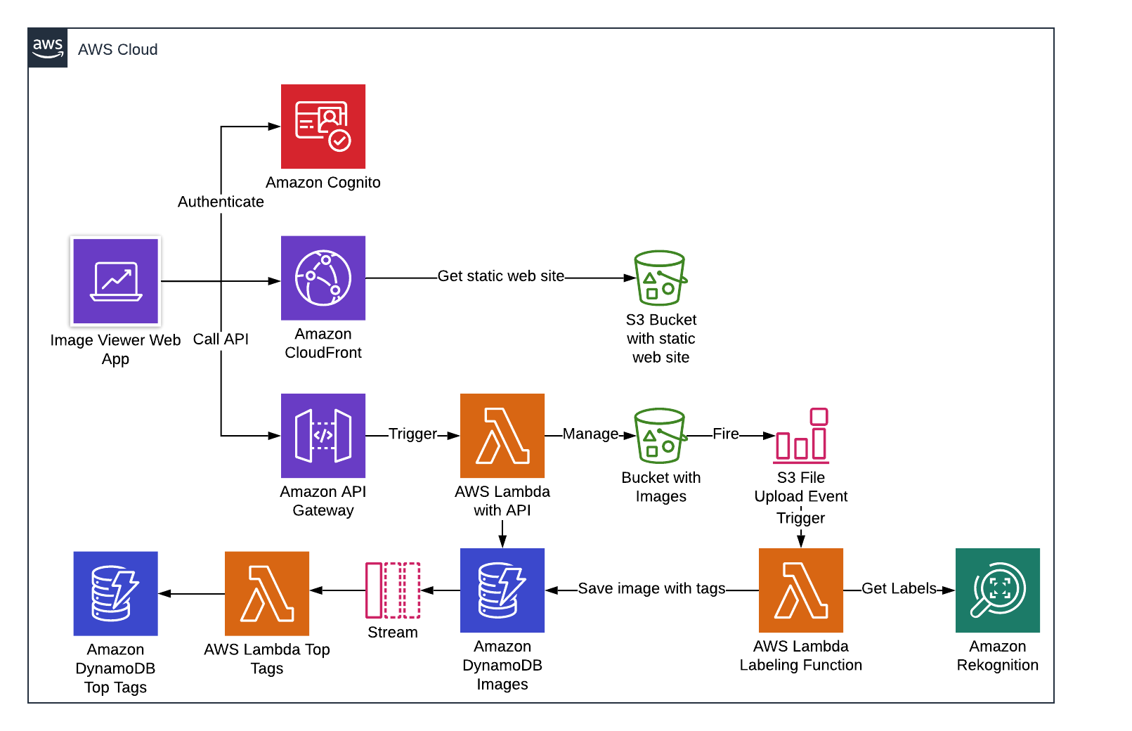
APPLICATION OVERVIEW. DYNAMODB —

Slide 64
PRACTICE —
https://github.com/illiasaveliev/image-viewer-databases

Slide 65
THANK YOU!

